Slide 1
Growing Incredible Managers:
Managing your team
Prepared by
Greg Mathers, Certified Adizes Senior Associate
May-July 2019

Slide 2


Appex
What are the PIPs facing Ghosh when takes over?
Agree on and be ready to discuss 3 key lessons from the case with Appex Corp.
Is there anything you think Ghosh should have done differently and if so, what is it?
©Adizes Institute 2019

Slide 3
Source of corporate success

Slide 4
Opportunities
Capabilities
External Integration
f
SUCCESS
Internal Disintegration
Mutual Trust
Mutual Respect

Slide 5
Mutual Trust and Respect
People
Notes:
55

Slide 6
Characteristics of a good manager
Is Well Rounded (Flexible in Style)
Knows Himself / Herself
Has Balanced View of Self
Accepts Self
Is Aware of Effect on Others
Can Identify Excellence in Others
Respects the Strengths of Others
Can Harness Conflict
Creates a Learning Environment
=
Mature, Well-Balanced Individual

Slide 7
Mutual Trust and Respect
Process
People
Notes:
77

Slide 8
8 Steps in Decision Making
Defreeze
Accumulate
Deliberate
Incubate
Illuminate
Accommodate
Finalize
Reinforce
Short Decision Making
Long Decision Making
Long Imp.
Short Imp.

Slide 9
Types of Decision Making
Problem
Identification
Task
Identification
Criteria
Selection
Solution
Finding
Implementation
Planning
Reinforcment
Defreeze
Accumulate
Deliberate
Incubate
Illuminate
Accommodate
Finalize
Reinforce

Slide 10
Mutual Trust and Respect
Mission,
Vision
&
Values
Process
People
Notes:
1010

Slide 11
Typical mistakes when making a Mission Statement:
Generic – can apply to any organization
Created for PR purposes
Not time bound/stagnant
Does not provide focus and thus energy
Creating the Mission without proper context
Not getting the buy in of the management team

Slide 12
Purpose of Mission Statement:
Align the management team around a common long term interest (increasing trust)
Provide managers a chance to sit in the seat of others, look at the situation from the CEO perspective (increasing respect)
Energize and focus the management team
Provide an opportunity to reevaluate the business model
Define what needs to be CHANGED

Slide 13

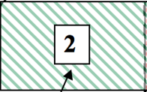
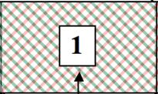
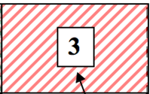

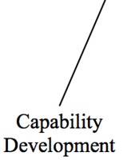
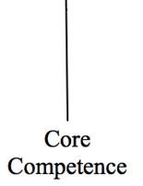

Market
Development
opportunity

Slide 14
Who Should help you create your Mission Statement?
Direct reports + additional people from:
-Finance
-R+D
-Marketing
-H.R. Development

Slide 15
How to communicate the Mission to the rest of the org.?
If you involve your management team their participation will guarantee their awareness of the Mission.
If they are able to contribute to the discussion in an open environment, (without compromsing the authority of top management) then they will buy into the Mission.
But you can’t have the whole organization involved in the meeting, what about them?

Slide 16
Information Gathering Teams
Client needs
Competition
Capabilities
Environment
Values

Slide 17
A Mission Statement has the following components:
We are in the business of _____________ and our purpose is _____________
We foresee the following changes happening externally and internally:_____________________
These changes mean _______________ to us
Based on what is happening and how it will affect us we need to _______________
We will accomplish these changes while developing the values of ________ dropping the values of _______ and keeping the values of _______

Slide 18
WE ARE– “We are in the business of serving (needs) We do this with (capabilities) … and our purpose is…”
Who do we serve? Who are the clients/customers/stakeholders? And what are their needs? Which needs do we serve? Which needs do we not serve? (Want/Should)

Slide 19
Example A- For GM, are the dealers the clients or the drivers who buy the cars? Whom do you want to focus on, whose needs do you want to maximize and whose needs do you want to satisfice?
Example B- In a research hospital the clients are the doctors doing the research, in a teaching hospital the students are the clients and in a normal hospital the patients are the clients.

Slide 20
Example C – Google. Who are their clients? The users or the advertisers?
Example D – Car component manufactures. Who are their clients? The people who buy the component (GM, Ford), the dealer, the end purchaser of the car or the car mechanic that will fix the car.

Slide 21
WE ARE– “We are in the business of serving (needs) We do this with (capabilities) , and in light of this our value proposition is… and our purpose is…”
Who do we serve? Who are the clients/customers/stakeholders? And what are their needs? Which needs do we serve? Which needs do we not serve? (Want/Should)
Why are we doing what we are doing? For what purpose? How do we want to be remembered?
IDENTIFY ANY THREATS OR OPPORTUNITIES

Slide 22
What is a Mission Statement?
WE FORSEE THE FOLLOWING CHANGES HAPPENING EXTERNALLY AND INTERNALLY: - “We project that in the future…”
Political
Legal
Socio- Cultural
Economic
Physical
Technology
Competition
IDENTIFY ANY THREATS OR OPPORTUNITIES

Slide 23
THESE CHANGES MEAN _______________ TO US – These are the possible effects our changing environment will have on us. “These environmental changes result in…”
THESE ARE THE THREATS OR OPPORTUNITIES

Slide 24
BASED ON WHAT IS HAPPENING AND HOW IT WILL AFFECT US WE NEED TO _______________
– These are the actions we feel we will need to take in order to deal with our changing environment.
“In light of our unique capabilities coupled with the need to address critical internal and environmental factors, over the next “X” years, it is imperative that we….”
-How far forward should the Mission Statement look? (what is the “X”?)
-How often should we revisit the Mission Statement?

Slide 25
WE WILL ACOMPLISH THIS WHILE DEVELOPING THE VALUES OF ________ DROPPING THE VALUES OF _______ AND KEEPING THE VALUES OF _______
The core beliefs that we do not want to violate when implementing our Call For Action.
“We will fulfill this mission while developing our … dropping our ... and maintaining our ….”

Slide 26
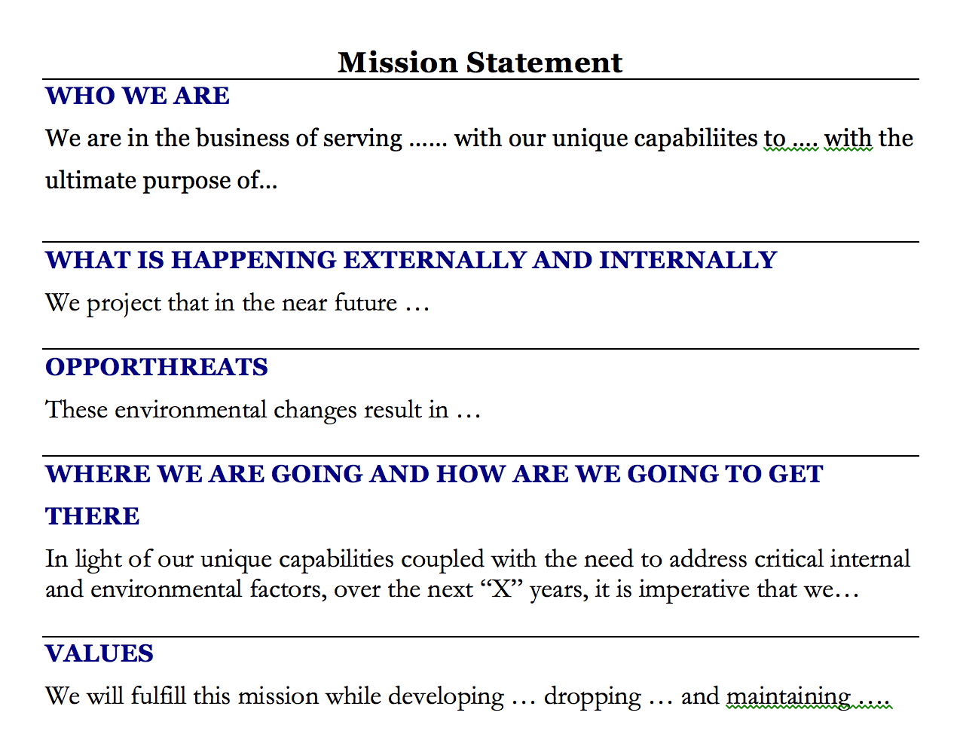
What is a Mission Statement?

Slide 27
Mutual Trust and Respect
Mission,
Vision
&
Values
Structure
Process
People
Notes:
2727

Slide 28
https://www.salon.com/2019/06/21/communing-with-the-dead-i-followed-the-grateful-dead-to-escape-and-ended-up-finding-home/
Thank You!
Next week article

